Slide 1
Active reconnaissance
Offensive security tactics for Linux professionals

Slide 2
Agenda
What is Active Reconnaissance?
Offensive ICMP
IPTables Firewall Enumeration
Stealth scanning techniques using NMAP/Scapy
Vulnerability Scanning With Burner Machines
Exposed Git repositories
How to protect your organisation?
Notes:
Quick agenda before starting this presentation. I’ll firstly be introducing active reconnaissance talking about its uses and pros/cons.
Next I’ll be talking about the offensive security uses of the ICMP protocol involving establishing backdoors and information gathering.
Moving onto enumerating firewall rules from the external perimeter and port scanning methods using tools such as NMAP and Scapy.
Next I’ll be discussing vulnerability/port scanning with burner machines.
I’ll also be discussing exposed git repositories and how this can help us offensively.

Slide 3
What is active reconnaissance?
Direct interaction with target organisation assets (Probing/scanning, sending/receiving data)
Higher risk of getting “burnt” (Blocked by organisation defences)
More reliable method of information gathering (Though less stealthy)
Notes:
Starting off with my first point. Active reconnaissance is a follow-up phase from passive reconnaissance. It involves direct interaction with the target which means to attempt port scans, sending data to the target servers trying to gain information through processes such as banner grabbing which can be gained passively. Coming to my next point. The higher risk of “getting burnt”. The definition of this is that you face a higher risk of getting detected by organisational defences and actively blocked. This would result in being burnt meaning you cannot proceed with a stealthy presence as you’ve sounded alarms and been caught.
However, aside from the dangers of active reconnaissance from an adversarial perspective: Active recon is more reliable as you are querying the target directly for information. This means you know for sure that the target is holding the information you are receiving in queries and it is not an outdated record. However, with high chances of accurate information can come the high probability of detection. So

Slide 4
Offensive ICMP
ICMP (Internet Control Messaging Protocol) designed to confirm availability of hosts on a network
Not always available on hosts to prevent host discovery from scanners
Data exfiltration/establishing reverse shell communications via “data” field (Covered in more detail in later presentations)
TTL response values to identify target operating system
Notes:
ICMP as you all know is a protocol designed for diagnostics and troubleshooting. If you can reach a device with a ping message, then great you know it’s up and running; otherwise, there might be a problem which ICMP might be able to tell you based on the error code which is given back. In an ideal world we’d always use ICMP to check for issues. But with security in the question, ICMP is not available because of its ability to allow host discovery for an attacker. Attackers can use off the shelf tools such as NMAP which generally send pings unless told not to which can allow scanners to discover hosts. It’s also not an unusual practice for ICMP being disabled on internal network hosts to harden the internal perimeter of a network.
However, where ICMP is available, there are multiple uses of ICMP other than host discovery such as establishing covert channels in addition to identifying an operating system.
Establishing a covert channel is not a part of active reconnaissance so it will be covered in later training sessions of this course where it is applicable. However, identification of an operating system using pings is a perfect example of active reconnaissance which will be discussed further here. So how can we find this information? When we send an ICMP packet from our end it is known as an ECHO Request message. If we get a response, we’ll see an ECHO reply which will contain a time to live known as the TTL. The TTL can help us identify an operating system since each key operating system type has its own TTL value which will be sent in ICMP communications shown in the next slide.
We can firstly make use of the payload/data field in which we can establish covert channel communications with our target. What does this mean? Consider a hardened host which is firewalled. Depending on how the firewall is configured such as having egress filtering, we can’t communicate with our attacking hosts from the target machine known as a reverse shell. However, if ICMP is available: ICMP is a completely separate communications channel which means any defenses applied to TCP/UDP would not exist for ICMP. The second point is that ICMP does not work at port level rather it uses echo request/reply packets to communicate which is the communications channel. Using

Slide 5
ICMP TTL values
Operating System | TTL value (Time To Live)
Linux | 64
Windows | 128
Network Devices (Cisco) | 255
Notes:
When analyzing the TTL value of any packet which has come as a reply of your ping request, the default TTL values will not always equate to what is being seen in the table. The reason for this is because ICMP packets go through packet hops which involve the packet going by several hosts to reach the destination. To get the true TTL values we can perform some simple maths where we use the formula of number of hops + TTL value which will give us one of the original TTL values in the table.

Slide 6
More os detection methods
NMAP OS Detection Engine (Very noisy and relies upon probability/guesswork)
p0f (Passive OS Detection Framework)
Cross-checking target service banners

Slide 7
Firewall Enumeration
IPTables – A Linux based firewall hooked into the kernel with high capabilities of traffic logging/prevention
IPTables firewall rules when misconfigured with rules such as REJECT can allow opportunities to enumerate open ports due to information disclosure
Enumerating outbound firewall rules can aid in payload weaponization to achieve infiltration or client side attack from external perimeter.

Slide 8
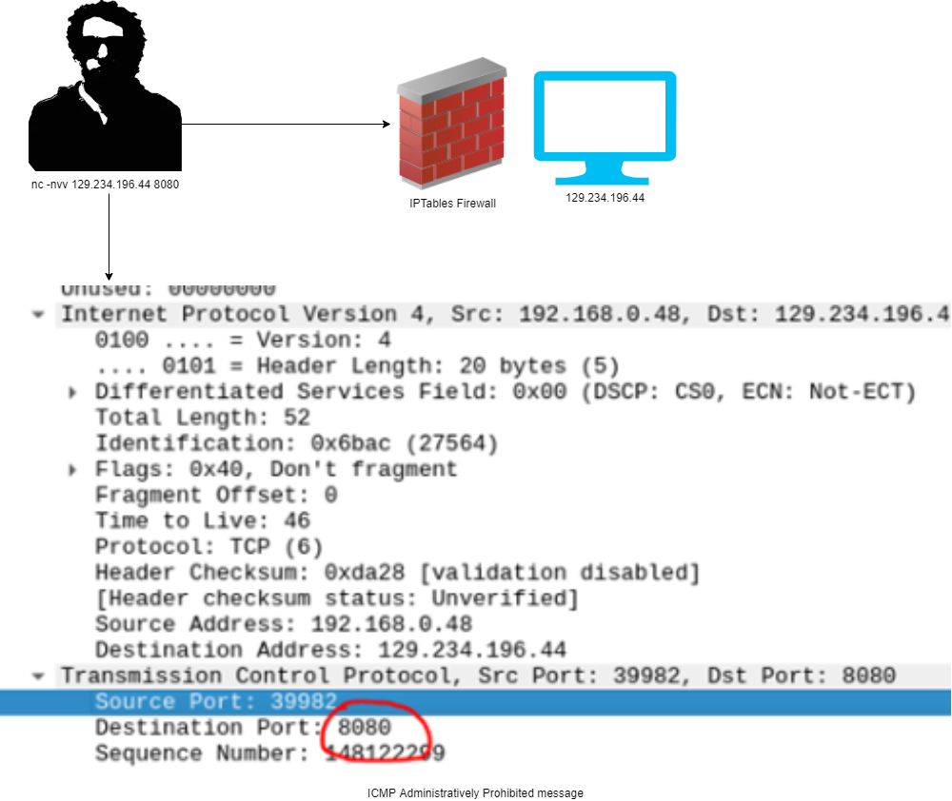
Firewall enumeration
Notes:
This example is from a previous pentest which was done on a system in Durham. This part of the test makes use of firewall enumeration in which open ports are enumerated based upon a misconfigured firewall. REJECT rules are used in order to serve as helpful messages to inform external users that they cannot connect to the port they wish to connect to. This is achieved using the ICMP protocol which responds with an administratively prohibited message, however internal ports designed to be protected from external exposure become leaked.

Slide 9
Port scanning
Active reconnaissance technique used to check the availability of a network port.
Port scanning can be conducted in many ways rather than a typical TCP connect.
Port scanning if done too loud/aggressively can cause defences to trigger.

Slide 10
Scanning methods
Using “exotic” TCP flags
Usual ports (Targeting most frequent ports) reducing payload size of scanning
Aggressive scans with known tools (Easy way of getting blocked)
Stealthier scans with custom tools (Preferable to remain hidden)

Slide 11
NMAP
One of the best port scanning tools capable to perform various port scanning techniques
Armed with a scripting engine allowing for customisation of traffic
Can be very loud sending a high volume of packets resulting in detection

Slide 12
Netcat
More barebones compared to NMAP but can be used for reverse shell operations
Can scan ports sending one packet to confirm availability but no scripting engine capabilities
Less traffic generation resulting in stealthier approach

Slide 13
SCapy
Packet crafting framework/Python libary. No ready made solution available
Scapy has extensive capabilities in order to create stealthy solutions
Knowledge of Python is required

Slide 14

Burner machines

Slide 15
What is a burner machine?
Similar to a throwaway email, a burner machine is intended for uses which provide anonymity to ones true identity
Online vulnerability search engines are available on the internet provide scanning capabilities with their own provided machines
Even if a burner machine provided by the scanner is blocked, we can maintain contact with the target as our own access is not blocked.
This leaves us with a potentially blocked connection from a separate machine, similar to performing a decoy scan using NMAP.

Slide 16
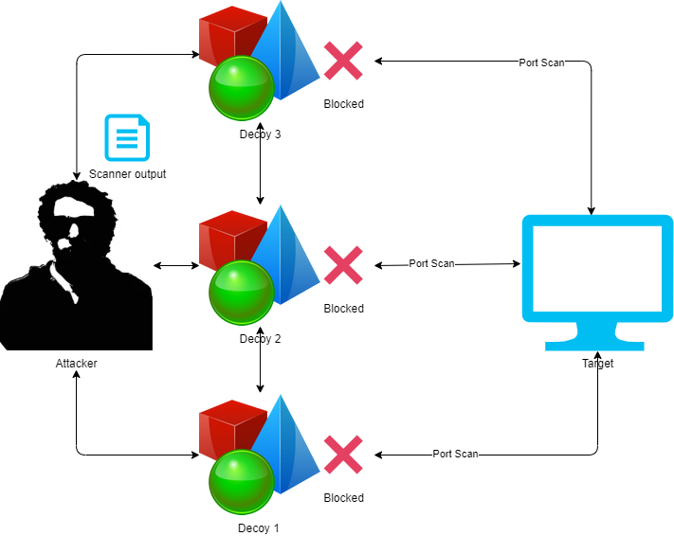
Decoy Scan

Slide 17
Shodan
A very powerful search engine with capabilities to scan target addresses from dedicated network addresses preventing detection.
Shodan can provide information through its powerful API and is a very powerful choice.
Shodan requires a paid membership to make use of however it is very powerful.

Slide 18
Censys
Free version of Shodan allowing for vulnerability scanning
Limited usage
Scanning is done from dedicated machine which belong to the Censys organisation making firewall rules a case of knowing the Censys subnet.

Slide 19
Zoomeye
Recognised as the Chinese version of Shodan
Only allowed to access 20 records without any subscription
Available from any device with an internet connection (Games console, Tablet, Mobile Phone)

Slide 20
Exposed Git repositories

Slide 21
Git repositories
A git repository is a useful source of version control and is designed to store source code and configuration files of an organisation.
If a git repository is exposed and reachable via the internet it is possible to clone internal source code and configuration files.
As a result, an attacker can clone the repository including Git objects and harvest any credentials or sensitive information which may result in authentication bypass or initial access to internal infrastructure.

Slide 22
How to protect your organisation?
Implement NIDS (Network Intrusion Detection System) such as Snort and port scanning defences such as PSAD (Port Scan Attack Detector)
Make use of DROP rules with IPTables firewall configuration instead of REJECT.
Block subnets belonging to Shodan, Censys, Natlas and Zoomeye to prevent scanning from proxy machines
Assess web server permissions of git repositories and other sensitive files exposed to the internet.

Slide 23

Questions

Slide 24
Next Talk: External Perimeter Testing

Slide 25
Thank you
Instructor: Aqeeb Hussain
GitHub: https://github.com/aqeebhussain122/hpc-offensive-security

